Slide 1
Time Series Analysis

Slide 2
Time series analysis
A big part of Statistics, particularly for financial and econometric data, is analyzing time series, data that are autocorrelated over time. Here one observation depends on previous observations and the order matters. There are number of builtin functions and packages to make working with time series easier.

Slide 3
Creating a time series
The ts() function will convert a numeric vector into an R time series object.
ts(vector, start=, end=, frequency=)
Start and End are the times of the first and last observation
Frequency is the number of observations per unit time (1=annual, 4=quartly, 12=monthly, etc.).

Slide 4
Example of time series
V<-c(1:72)
myts<-ts(v,start=(2011,1),frequency=12)
myts
Jan Feb Mar Apr May Jun Jul Aug Sep Oct Nov Dec
2011 1 2 3 4 5 6 7 8 9 10 11 12
2012 13 14 15 16 17 18 19 20 21 22 23 24
2013 25 26 27 28 29 30 31 32 33 34 35 36
2014 37 38 39 40 41 42 43 44 45 46 47 48
2015 49 50 51 52 53 54 55 56 57 58 59 60
2016 61 62 63 64 65 66 67 68 69 70 71 72

Slide 5
Example of time series data
1. Global warming data
2. Monthly earnings of a company
3. Stock exchange of data
4. Neurological data

Slide 6
1. Additive model of Time Series
The additive model for a given time series y 1 , . . . , y n is the assumption that these time series data are realizations of random variables Y t that are themselves sums of four components
Y t = T (t) + Z( t) + S( t) + R (t) -(1)
Trend : T is a monotone function called trend
Cyclic component: Z is the non random long term cyclic influence
Season component: S is the non random short term cyclic influence
Random component: R is the random variable

Slide 7
2.Multiplicative model of Time Series
Multiplicative model assumes that time series data is multiple of these factors.
Y(t)=Level*Trend*Seasonality*Noise

Slide 8
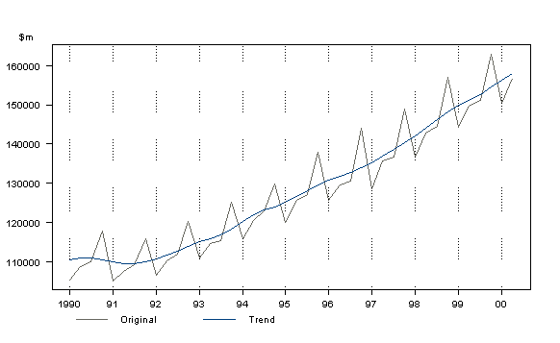
Trend
Trend: Trend is defined as the ‘long term’ movement in a time series without calendar related and irregular effects, and is a reflection of the underlying level. It is the result of influences such as population growth, price inflation and general economic changes. The following graph depicts a series in which there is an obvious upward trend over time.

Slide 9
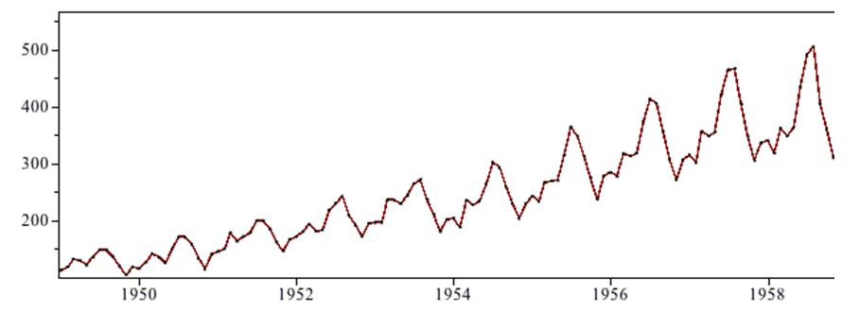
Seasonal Component
All the components associated with time are known as seasonal component. So in time searies data seasonality refers to periodic fluctuations in certain business areas that occur regularly based on a particular season. This season can be calender season or holiday season.Seasonality is always of a fixed and known period. It is easy to estimate.

Slide 10
Cyclic Component
A cyclic pattern exists when data exhibit rises and falls that are not of fixed period.

Slide 11
Noise
In discrete time, white noise is a discrete signal whose samples are regarded as a sequence of serially uncorrelated random variables with zero mean and finite variance.

Slide 12
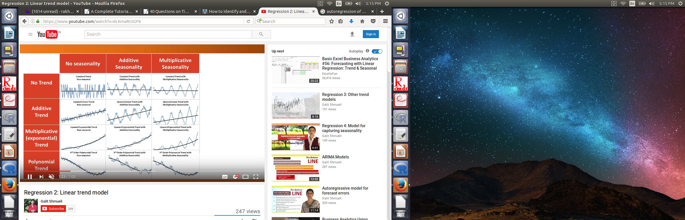
Different types of Graph

Slide 13
Autocovariance
Autocovariance measures the linear dependence between two points on the same series observed at different times.
γ(s, t) = cov(x(s),x(t)) = E[(x(s)−μ(s))(x(t)−μ(t))],
In very smooth series autocovariance is very large when t and s is very far.
In choppy series autocovariance is nearly 0 for large separations.

Slide 14
Autocorrelation
The most important step in constructing a model is to determine the structure of dependence.Autocorrelation is a mathematical representation of the degree of similarity between a given time series and a lagged version of itself over successive time intervals. It is the same as calculating the correlation between two different time series, except that the same time series is used twice: once in its original form and once lagged one or more time periods.
ρ(s, t) =γ(s, t)/ (γ(s, s)γ(t, t))^1/2
The resulting output can range from +1 to - 1 in line with the traditional correlation statistic. An autocorrelation of 1 represents a perfect positive correlation (an increase seen in one time series leads to a proportionate increase in the other time series). An autocorrelation of negative 1, on the other hand, represents perfect negative correlation (an increase seen in one-time series results in a proportionate decrease in the other time series).
Autocorrelation measures linear relationships; even if the autocorrelation is miniscule, there may still be a nonlinear relationship between a time series and a lagged version of itself.

Slide 15
Example of Autocorrelation
Assume an investor is looking to discern if a stock's returns in her portfolio exhibit autocorrelation; the stock's returns are related to its returns in previous trading sessions. If the returns do exhibit autocorrelation, the stock could be characterized as a momentum stock; its past returns seem to influence its future returns. The investor runs a regression with two prior trading sessions' returns as the independent variables and the current return as the dependent variable. She finds that returns one day prior have a positive autocorrelation of 0.7, while the returns two days prior have a positive autocorrelation of 0.3.

Slide 16
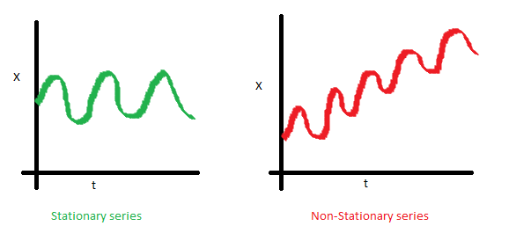
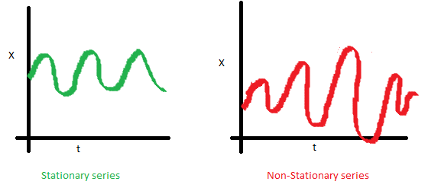
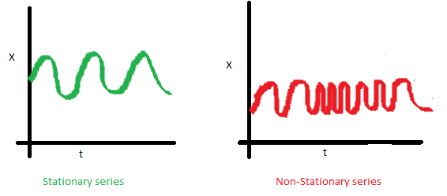
Autocorrleation and Correlogram in R

Slide 17
Stationary/Non Stationary time series
Stationary time series is one whose statistical properties such as mean, variance, autocorrelation, etc. are all constant over time.
Non-stationary process that has a variable variance and a mean that does not remain near close to each other.

Slide 18
Non Stationary to Stationary time series
Most statistical forecasting methods are based on the assumption that the time series can be rendered approximately stationary through the use of mathematical transformations.
A stationarized series is relatively easy to predict: you simply predict that its statistical properties will be the same in the future as they have been in the past!
The predictions for the stationarized series can then be "untransformed," by reversing whatever mathematical transformations were previously used, to obtain predictions for the original series.
Thus, finding the sequence of transformations needed to stationarize a time series often provides important clues in the search for an appropriate forecasting model.

Slide 19
Weak Stationary series
A weak stationary series has constant mean and autocovariance function depend on s and t.

Slide 20
Non Stationary to Stationary time series
Most business and economic time series are far from stationary when expressed in their original units of measurement.
Even after deflation/ seasonal adjustment they will typically still exhibit trends, cycles, random-walking, and other non-stationary behavior.
If the series has a stable long-run trend and tends to revert to the trend line following a disturbance, it may be possible to stationarize it by de-trending (fitting a trend line and subtracting it out prior to fitting a model/including the time index as an independent variable in a regression). Such a series is said to be trend-stationary.
However, sometimes even de-trending is not sufficient to make the series stationary, in which case it may be necessary to transform it into a series of period-to-period and/or season-to-season differences called differencing.

Slide 21
Removing Seasonality/ Deseasonalizing
As discussed earlier seasonal variation or seasonality are cycles that repeat regularly over time. A time series where the seasonal component has been removed is called seasonal stationary. A time series with a clear seasonal component is referred to as non-stationary.
Removing the seasonal component result in clear relationship between input and output variables.
Seasonality can be daily, weekly, monthly, yearly and so on.
First plot your data to check whether seasonality exist.

Slide 22
Deseasonalizing-2) Modeling seasonal adjustment
We can model the seasonal component directly, then subtract it from the observations.
The seasonal component in a given time series is likely a sine wave over a generally fixed period and amplitude. This can be approximated easily using a curve-fitting method.

Slide 23
Deseasonalizing-1) Differencing
If there is a seasonal component at the level of one week, then we can remove it on an observation today by subtracting the value from last week.
In case of annual seasonality we can remove by subtracting min value from last year or average value of same month from last year.

Slide 24
Smothing Method-
In statistics and image processing, to smooth a data set is to create an approximating function that attempts to capture important patterns in the data, while leaving out noise or other fine-scale structures/rapid phenomena.

Slide 25
Differencing
It helps to remove the trend or seasonality from the time series.
It means taking the difference between two value of the series.
Lag means how far apart these two values are.

Slide 26
Differening
Lag-1: y(t)-y(t+1)
It is helpful in removing trend
Lag-M: y(t)-y(t-m)
It is useful for removing seasonality with M seasons.
Double Differencing
Perform the operation twice. It is useful when we want to remove the trend as well as seasonality.

Slide 27
Moving Average Smoothing
Moving Average Smoothing, each observation is assigned an equal weight, and each observation is forecasted by using the average of the previous observation(s). The number of previous observation is called window.
There are two type of window. Window centered around time t, window backwards from time t.
How many observation we take in MA(p) is defined by correlation between x(t) and x(t-1), x(t-2) and so on untill we get 0 value.
Using the time series X1, X2, X3, ....., Xt, this smoothing technique predicts Xt+k as follows :
St = Average (x(t-k+1), x(t-k+2), ....., xt), t= k, k+1, k+2, ...N
We when choosing this parameter, a large parameter value will oversmooth the data, while a small parameter value will undersmooth the data.
This technique should not be applied when seasonality is present in the data set. It reverals the levels and trend of series surpassing the seasoal and random components.

Slide 28
Moving Average-Smoothing
Centered moving average with lag 5:
F=(x(t-2)+x(t-1)+x(t)+x(t+1)+x(t+2))/5
We use this method in visualizing
Trailed moving average with lag 5:
F=(x(t-4)+x(t-3)+x(t-2)+x(t-1)+x(t))/5
We use this method in forecasting. But it does not capture trend or seasonality so it is better to use it with series that do not have this component.

Slide 29
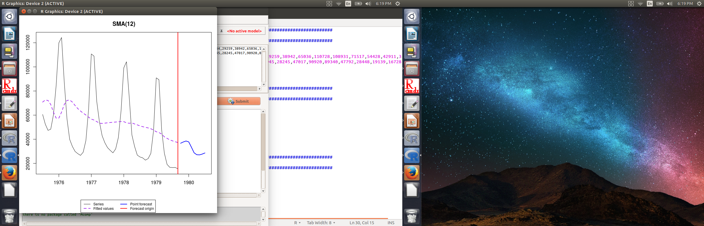
Graph of Moving average

Slide 30
Window width in moving average
If we take window as the whole data then we will get the mean of data as the output and it will be a single value. It leads to over smoothing.
If we take very small window then we get almost same value as series and it will be under smoothing.

Slide 31
Exponential Smothing
Exponential Smoothing is one of the more popular smoothing techniques due to its flexibility, ease in calculation, and good performance.
Exponential Smoothing uses a simple average calculation to assign exponentially decreasing weights starting with the most recent observations. It gives more weight to recent observation and less to old observation.
S0= x0
St = αx(t-1) + (1-α)st-1, t > 0
Exponential Smoothing should only be used when the data set contains no seasonality.
The forecast is a constant value that is the smoothed value of the last observation.

Slide 32
Double Exponential Smoothing
Double Exponential Smoothing can be defined as the recursive application of an exponential filter twice in a time series.
Double Exponential Smoothing should not be used when the data includes seasonality.
this technique should be used when a trend is inherent in the data set,
St = At + Bt , t = 1,2,3,..., N
Where, At = ax(t) + (1- a) S(t-1) 0< a <= 1
Bt = b (A(t) - A(t-1)) + (1 - b ) B(t-1) 0< b <= 1
The forecast equation is: X(t+k) = A(t) + K B(t) , K = 1, 2, 3, ...

Slide 33
Auto Regression
Autoregressive model is when a value from a time series is regressed on previous value from the same series.
We need to define the lag in AR defined as AR(p)
AR(1) means we are regressing x with previous value
x=a+b1*x(t-1) +e(iid) where e is iid is error with mean=0 and varinace=(sigma)^2.
AR(3) means we are regressing x with previous 3 values
x= a + b1*x(t-1) + b2*x(t-2) + b3*x(t-3)
The value of p can be determined by partial autocorrelation. The maximum value of p is one beyond which partial auto correlation is 0.
The Autoregression is best applied on seasonally adjusted series or time series should be stationary (No seasonality/No trend). Constant mean, variance and autocorrelation.

Slide 34
Condition of Auto Regression
No trend/Seasonality
Constant level, Variance and autocorrelation.
Capture trend/Seasonality by regression/smoothing/differencing
Apply autoregression by AR or ARMA model.

Slide 35
ARMA
It stands for Auto Regression moving average method and used only for forecasting. They are very flexible and capture various type of pattern.
AR Model
y(p)=b0+b1*y(t-1)+b2*y(t-2)....bp+y(t-p)
ARMA(p,q)
y(p)=b0+b1*y(t-1)+b2*y(t-2)....bp+y(t-p)+
e(t)+a1*e(t-1)+a2*e(t-2).....+aq*e(t-q)
It has two components, p for regression and q for forecast error also called moving average component.

Slide 36
Condition for ARMA
No trend/Seasonality
Constant mean
Constant variance
Constant autocorrelation
Series should be stationary

Slide 37
ARIMA
It stands for Auto regressive integrated moving average model.
It has three parameters. p,d,q where is for lag of auto regression, d for differencing and q for moving average method.
First this model performs differencing of lag-1.
By d we can control how many times we want to apply differencing.

Slide 38
ARIMA
The p,d,q needs to choosed carefully.

Slide 39
Triple Exponential Moving Average

Slide 40
Plotting time series
A time series with additive trend, seasonal, and irregular components can be decomposed using the stl() function. Note that a series with multiplicative effects can often by transformed into series with additive effects through a log transformation (i.e., newts <- log(myts)).
fit <- stl(myts, s.window="period")
plot(fit)

Slide 41
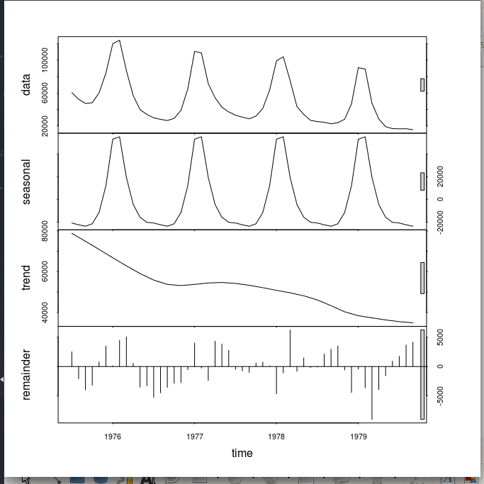
Graph of German data

